Slide 1
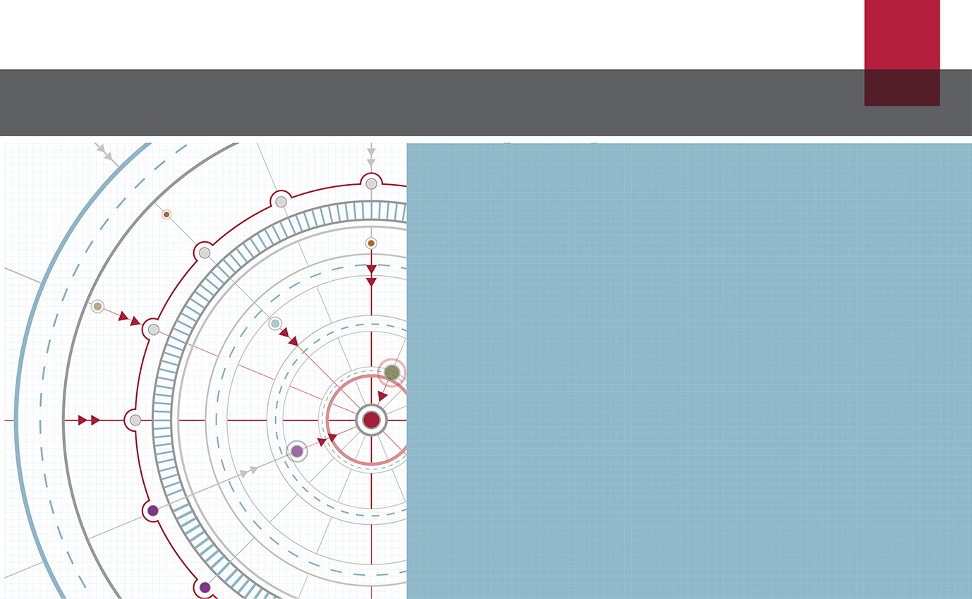
The role of the IASB in international financial reporting: Mission achieved?
IFRS® Foundation
Ann Tarca IASB Member
IAAER/ IAS AAA mid-year meeting
Miami, January 2019
The views expressed in this presentation are those of the presenter, not necessarily those of the International Accounting Standards Board (the Board) or IFRS Foundation.
Copyright © IFRS Foundation. All rights reserved

Slide 2
Introduction (1)
The IASB was formed in 2001 with the objective of setting accounting standards for use by companies listed on the world’s capital markets.
The IFRS mission statement is on a following slide.
IFRS Standards, now used in 144 jurisdictions, cover a broad range of topics.
My talk looks at evidence about impact of IFRS from studies of foreign investment activity.
I pose the question: does evidence show the IFRS mission is being achieved?

Slide 3
Introduction (2)
Scene setting: IFRS Foundation, the IASB and IFRS Standards. IASB achievements, use of IFRS.
Benefits of IFRS Standards: Academic evidence – cross-border investment. Evidence of ‘real’ impact of IFRS.
IFRS Foundation and other organisations: Rationale for co-operation. IFRS Foundation role in working collaboratively to promote high quality application of IFRS standards.

Slide 4
Scene setting
IFRS Foundation
4
Copyright © IFRS Foundation. All rights reserved

Slide 5
IFRS Foundation Mission Statement
To develop IFRS® Standards that bring transparency, accountability and efficiency to financial markets around the world.
Our work serves the public interest by fostering trust, growth and long-term financial stability in the global economy.

Slide 6
IFRS Foundation – 3 tier structure
Monitoring Board
Public accountability
Trustees
Governance & oversight
International Accounting Standards Board
International Accounting Standards Board
Independent standard-setting

Slide 7
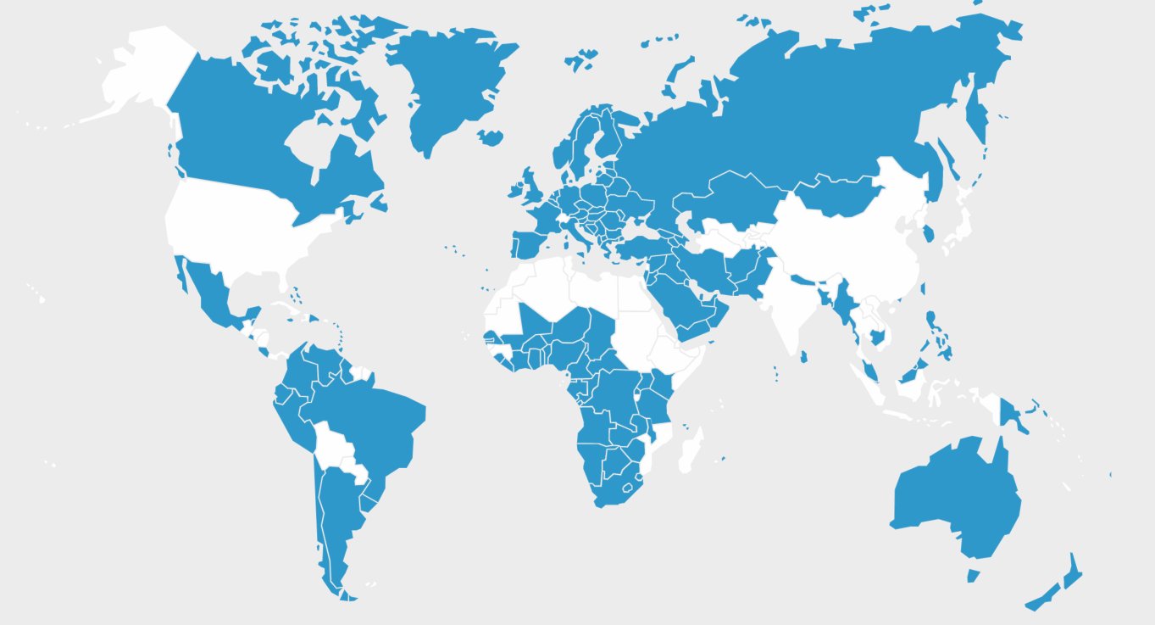
Adoption of IFRS® Standards
144 of 166 jurisdictions require IFRS Standards for all or most publicly accountable companies
87%
= IFRS Standards required

Slide 8
Use of IFRS Standards around the world
Require IFRS Standards
Permit IFRS Standards
Neither require nor permit IFRS Standards

Slide 9
Use of standards IFRS and IFRS for SMEs

Slide 10
Remaining major economies
Country | Status
China | ‘Substantially converged’ with IFRS Most dual-listed Chinese companies already produce IFRS financial statements October 2015 ‘Beijing Statement’ reaffirms China’s commitment to achieve full convergence
India | Ind AS ‘substantially converged’ with IFRS
Japan | Permit voluntary use of IFRS, ≈30% of total market cap now report using IFRS
United States | 500+ non-US companies report using IFRS Domestic consideration stalled

Slide 11
Standard setting activity
IAS 1 - IAS 41 and IFRS 1 - IFRS 17
Announcement of adoption of IFRS in EU in 2005
FASB Convergence program 2006 - 2013
Completion of major standards IFRS 15, IFRS 16, IFRS 9 and IFRS 17
Better communication initiative
Research and Standard setting agendas
Engagement with stakeholders throughout the process
Notes:
Better communication: DI, PFS, MCPS
Agenda consultation re research and standard setting agenda. 2013 feedback guides projects undertaken.
Stakeholder engagement: CMAC, GPF, EEG, ITCG.

Slide 12
Implementation support
12
What we do….
Explain what the Board had in mind when developing the new requirements
We do this to support consistent understanding of those new requirements
What we don’t do….
Provide answers to specific questions or give opinions on specific contracts or fact patterns

Slide 13
Support for new Standards
Educational Webinars
Transition Resource Group
Board and Committee public discussions
New Standards
Education- regulators, NSS, investors
Conferences
Narrow-scope standard-setting

Slide 14
Support for Standards in effect
Interpretations process
Narrow-scope standard-setting
Agenda decisions
Standards in effect
Working with other organisations such as regulators and NSS
Educational materials
Notes:
In 2012 the Interpretation Committee procedures were changed so that it could deal with a wider range of requests and have more methods to address implementation matters.
In 2018 the Interpretations Committee discussed 22 topics, of which 16 were addressed by the Committee leading to 14 Agenda Decisions with explanatory material and and two amendments or additions to IFRS Standards.

Slide 15
Benefits of adoption of IFRS Standards
IFRS Foundation
15
Copyright © IFRS Foundation. All rights reserved

Slide 16
Evidence of benefits of adoption of IFRS Standards
Improved transparency
Lower cost of capital
Improved cross-country investment
Better comparability of financial reports
Increased following by analysts
(de George, Li and Shivakumar 2016)

Slide 17
Benefits can vary…
Benefits vary between firms and countries
Observed benefits may reflect country setting and institutions
Extent of change from prior GAAP
Managerial incentives
Education and training
Legal institutions and enforcement of accounting standards

Slide 18
Studies of benefits of adoption of IFRS
Singleton-Green (2016)
Inconclusive evidence on many issues
Benefits not uniform, source of benefits unclear
Data may not be representative
Little is known about costs
Some findings are contradictory, lack of reconciliation of evidence
What do we know about outcomes associated with IFRS adoption?
i.e. the benefits of greater transparency and accountability? Is there more efficiency in financial markets?

Slide 19
Examining outcomes - IFRS evidence re foreign investment
Improved financial reporting quality and comparability can lead to more cross-border capital flows and better integration of capital markets (EC 2002).
IFRS benefits (de George et al. 2016)
decrease the information advantage of foreign investors - help foreign investors assess firms and markets
higher quality standards than prior GAAP – decrease information asymmetry foreign and local investors
Increase visibility of remote investments
Notes:
EU IFRS adoption was motivated by plans to develop single capital market –RJ Chambers, Zeff.

Slide 20
Evidence of benefits of IFRS (1) – moderated by country setting
Ownership by foreign mutual funds increases when entities use IAS. More likely when information environment is poor and firms have lower visibility (Covrig, Defond and Hung 2007: 29 countries, 1999-2002).
In IFRS adopting countries, US home bias decreased. Larger decrease for greater difference in stds, stricter rule of law, and more incentive to report high quality information (Khurana and Michas 2011; 85 countries, 2003-2007).
US home bias decreased only in countries with strong enforcement (Shima and Gordon 2011: 44 countries, 2003-2006)
Notes:
CDH: Mutual fund holdings. Information environment = number of analysts and size of company. IAS adoption from Datastream.
KM:2003,2004 and 2006,2007. US investors. 85 cty of which 33 adopted IFRS 2003-2007; 30 mandated local stds; 22 mandated IFRS before 2003. Deloitte IAS Plus.
Results hold for other country proxies: economic indicators, familiarity (language, geograhic distance), equity mkt development, legal and ownership environment.
Difference in stds = Bae et al. Rule of Law Kaufmann.
SG: also US investors in foreign equity. ‘IFRS reduce information asymmetry if institutional features align with investors needs’.

Slide 21
Evidence of benefits of IFRS (2)
IFRS adopting countries:
Increase in institutional investment and number of institutional investors. Benefits mainly for active investors (value and growth investors). More effect when enforcement and reporting incentives are stronger and divergence from local stds is high (Florou and Pope 2012: 45 countries 2003-2006)
Increase in foreign direct investment. Increased inflow in developing economies (World Bank finance) (Gordon, Loeb and Zhu 2012: 124 countries 1996-2009)
Notes:
FP: include a broad set of investors (domestic foreign MF; pension funds; insurance coys; hedge funds; private equity funds; venture capital funds). Use Leuz country clusters for enforcement and incentives. Ding for acct stds divergence.
do not distinguish between domestic and foreign institutional investors so we don’t know if domestic investors are increasing stake (due to higher accounting quality) or IFRS standards (more transparency) attracting foreign investors.
GLZ: look at FDI (World bank data). FDI increases for countries adopting IFRS. The most effect is for developing economies. Adoption is promoted by need for World Bank finance (2 stage IV analysis).

Slide 22
Evidence of benefits of IFRS (3)
Increase in foreign equity investment
In countries with higher: governance quality, economic development and creditor rights (prior to adoption)
Primarily from US
Increase in foreign debt investment in all adopting countries
From US and other non-adopting countries
Increase in investment reflects increase in financial reporting quality (rather than comparability) (Beneish, Miller and Yohn 2015: 23 countries, 2003-2007)
Notes:
BMY: FPI relies on financial statement info (more than FDI). Consider economic development, creditor rights, and governance quality. Debt not associated with these characteristics.
Deflate FI by mkt cap or GDP. Change in equity/debt 2003 to 2007. GOV = Kaufmann.

Slide 23
Evidence of benefits of IFRS (4) – from standards
Greater cross-border investment when implementation of IFRS improves comparability (industry uniformity) and is credible (DeFond, Hu, Hung and Li, 14 Eu countries, 2003-2007)
Foreign investment increases in countries using IFRS (from IFRS countries) due to familiarity with standards (Amiram 2012: 104 countries, 1997, 2001-2006)
Foreign mutual funds increased holdings in firms in IFRS adopting countries - familiarity with standards encouraged cross-border investment (Yu and Wahid 2014)
Notes:
DHHL: MF ownership – global, regional, other. Uniformity self-constructed based on industry. Leuz et al 2013 – country variables for credibility of implementation. Increase foreign MF ownership by foreign global funds, not by domestic mutual funds.
Amiram: FPI – foreign portfolio investment. Do not have control like FDI. the effect of accounting familiarity is more pronounced when investor and investee countries share language, culture, legal origin and region. FPI increased with adoption of IFRS; the increase comes from countries that also use IFRS. Investors seek familiar accounting language. This factors is stronger than the other factors and when present increases their effect too.
YW: Accounting distance positive association with being underweight (investee local stds vs stds of investors’ country). Both can change which will affect accounting distance.
Investee firms can switch to IFRS. Investors country can switch to IFRS. AD is based on Bae et al. Measure of over/underweight considers % of ownership of each country-fund after considering the size of the country-fund assets in the global market portfolio.

Slide 24
IFRS adoption - evidence re investment efficiency (1)
In IFRS adopting countries:
Higher investment efficiency. Stronger association where legal protections weaker, more concentrated ownership, larger GAAP difference (Biddle, Callahan, Hong and Knowles (2013: 26 countries, 2001-2008)
More comparability – better information about foreign peers (Chen, Young and Zhuang 2013: 17 countries, 2000-2009)
More cross-border acquisitions by entities from IFRS and non-IFRS countries, mainly from adopting countries and when reporting uniformity is higher (Louis and Urcan 2014: 20 countries, 2000-2010)
Notes:
Biddle: investment efficiency is measured based on by investment-cash flow sensitivity and value-enhancing risk taking.
Louis Urcan: reporting uniformity measured as in Defond 2011
CNZ: 17 EU countries, mandatory adopters. ROA difference between firms and their peers (foreign peers/domestic group peers).

Slide 25
IFRS adoption - evidence re investment efficiency (2)
For IFRS adopting firms:
Lower IPO underpricing, increased proceeds from foreign markets. Greater impact with more accounting changes and implementation credibility (Hong, Hung and Lobo 2014: 29 countries, 2003-2007)
Highly likelihood of cross-listing in IFRS adopting countries and large, more liquid markets. More effect if accounting differences greater, disclosure was lower and firms had less access to capital (Chen, Ng and Tsang 2015: 50 countries 2003-2007)
Notes:
HHL:1540 IPOs in 20 cty mandating IFRS in 2005. Compare underpricing and relative foreign proceeds from pre 2003,2004 and post 2006,2007. (1) Local Gaap firms PSM with IFRS firms (2) same excluding US IPOs (3) local gaap users in developed non-IFRS countries.
“IFRS reduces information asymmetry and helps firms raise capital at lower cost – facilitates cross border capital raising’.
Implementation credibility = rule of law. Accounting differences = Nobes 2001.
CNT: 34 home countries (17 IFRS 17 non-IFRS), 50 target countries. Look at cross listing propensity/intensity/venue choice in pre-post periods. USE PSM matched firms.

Slide 26
Further evidence
Use of IFRS-converged standards in China (2005-6 and 2007-8):
Foreign institutional investment declines
More decline for companies with more opportunity to manipulate (via fair value measurement)
Relation of earnings and returns declines
Decline in investment greater for countries with relationship-based institutions
Home country IFRS experience attenuates (exacerbates) the decline for market-based (relationship-based) countries
(Defond, Gao, Li and Xia 2018).
Notes:
QFII investments are a very small proportion of total foreign investment in China
The 2007-2008 period is when many foreign companies were liquidating their Chinese investments because they needed to increase capital following the financial crises.
China made many changes since deciding to attract foreign investment 40 years ago. (1) law was changed to protect foreign investors, allow them to take profits out of China (2) accounting standards were harmonised with IAS to improve the information available to foreign investors.
The research design in flawed because standards were already harmonised in 2005-2006 period. There is not ‘big bang’ adoption. There are errors in the paper about the requirements of accounting standards in 2005-2006 period.
Consider Table 2. Which are the relationship-based countries with IFRS experience?
Consider Appendix A Which MNCs are the relationship-based ones? The are international companies with international influences that may well drive their culture more than their country of origin.

Slide 27
Research opportunities
Evidence in support
Adoption of IFRS, more foreign investment
More evidence required
Longer time periods
Developing countries
Finer understanding of ‘adoption’ and ‘convergence’
Implications of measures of FDI used
Considering confounding events
Newer, more refined proxies for institutional setting
More recognition of limitations of proxies
Care in interpretation, check with practitioners

Slide 28
IFRS Foundation Working with other organisations
IFRS Foundation
28
Copyright © IFRS Foundation. All rights reserved

Slide 29
IFRS Foundation – working co-operatively
National standard setters (Accounting Standards Advisory Forum, World Standard Setters, International Federation of Accounting Standard Setters)
World Bank (MOU)
IOSCO, national security market regulators, Monitoring Board
Basel Committee on Banking Supervision (Accounting Expert Group)
Financial Stability Board, EFRAG
Notes:
ASAF four meetings a year. WSS IFAAS once a year.
The World Bank aims to increase trade and financing in emerging economies and considers IFRS Standards have a fundamental role in its activities. The World Bank and the IFRS Foundation signed a MOU in 2017 to develop education materials and to support IFRS implementation in developing economies

Slide 30
World Bank and IFRS Foundation - Overlapping objectives
Unreliable financial information can restrict access to finance
IFRS Foundation
Standards that foster trust, growth and long term financial stability in the global economy
World Bank
End extreme poverty within a generation and boost shared prosperity
Strong financial markets boost economic development
Investor trust leads to stronger capital markets

Slide 31
In conclusion…
Cross-border investment increased and investment efficiency improved following adoption of IFRS
Benefits depend upon:
High quality standards
Implementation support
Institutional setting in adopting countries
IFRS Foundation works with a range of organisations to produce high quality standards and to support effective implementation
We value the contribution of academic evidence to the quality and robustness of standard setting
Notes:
Benefits of adoption of IFRS Standards depend upon:
High quality standards – challenges for IASB to produce HQ standards, meet needs of primary users of financial statements (investors)
Implementation support – role of auditors – considered important by investors, but under pressure from groups claiming that auditors is failing’.
Institutional setting in adopting countries – consistently shown to be important. What is meant by institutional setting? Legal protections. Corporate governance. Level of corruption. Role of enforcement agencies eg actions by security market regulators to promote fair and efficient markets.
Stds alone are insufficient for high quality reporting and consequent benefits.
Other institutions are important. IFRS Foundation works with a range of institutions to ensure success of adoption of IFRS.

Slide 32
Bibliography
Amiram, D. (2012). Financial information globalization and foreign investment decisions. Journal of International Accounting Research, 11(2), 57-81.
Singleton-Green, B. (2015) The Effects of Mandatory IFRS Adoption in the EU: A Review of Empirical Research. Available at SSRN: https://ssrn.com/abstract=2515391
DeFond, M., Hu, X., Hung, M., & Li, S. (2011). The impact of mandatory IFRS adoption on foreign mutual fund ownership: The role of comparability. Journal of Accounting and Economics, 51(3), 240-258.
DeFond, M., Gao, X., Li, O. Z., & Xia, L. (2018). IFRS adoption in China and foreign institutional investments. China Journal of Accounting Research. Forthcoming.
De George, E. T., Li, X., & Shivakumar, L. (2016). A review of the IFRS adoption literature. Review of Accounting Studies, 21(3), 898-1004.
Beneish, M. D., Miller, B. P., & Yohn, T. L. (2015). Macroeconomic evidence on the impact of mandatory IFRS adoption on equity and debt markets. Journal of Accounting and Public Policy, 34(1), 1-27.
Biddle, G. C., Callahan, C. M., Hong, H. A., & Knowles, R. L. (2016). Do Adoptions of International Financial Reporting Standards Enhance Capital Investment Efficiency?. Available at SSRN: https://ssrn.com/abstract=2353693 or http://dx.doi.org/10.2139/ssrn.2353693

Slide 33
Bibliography
Chen, L., Ng, J., & Tsang, A. (2014). The effect of mandatory IFRS adoption on international cross-listings. The Accounting Review, 90(4), 1395-1435.
Covrig, V. M., Defond, M. L., & Hung, M. (2007). Home bias, foreign mutual fund holdings, and the voluntary adoption of international accounting standards. Journal of Accounting Research, 45(1), 41-70.
Florou, A., & Pope, P. F. (2012). Mandatory IFRS adoption and institutional investment decisions. The Accounting Review, 87(6), 1993-2025.
Gordon, L. A., Loeb, M. P., & Zhu, W. (2012). The impact of IFRS adoption on foreign direct investment. Journal of Accounting and Public Policy, 31(4), 374-398.Khurana, I. K., & Michas, P. N. (2011). Mandatory IFRS adoption and the US home bias. Accounting Horizons, 25(4), 729-753.
Hong, H. A., Hung, M., & Lobo, G. J. (2014). The impact of mandatory IFRS adoption on IPOs in global capital markets. The Accounting Review, 89(4), 1365-1397.
Louis, H., & Urcan, O. (2014). The effect of IFRS on cross-border acquisitions. Available at SSRN: https://ssrn.com/abstract=2164995 or http://dx.doi.org/10.2139/ssrn.2164995
Shima, K. M., & Gordon, E. A. (2011). IFRS and the regulatory environment: The case of US investor allocation choice. Journal of Accounting and Public Policy, 30(5), 481-500.
Yu, G., & Wahid, A. S. (2014). Accounting standards and international portfolio holdings. The Accounting Review, 89(5), 1895-1930.

